Slide 1
ACCESS TO HEALTH CARE FOR DOMESTIC WORKERS
31 OCT 2019, Monash University
SUMITHA SHAANTHINI KISHNA
DIRECTOR
OUR JOURNEY

Slide 2
Country of origin countries
Indonesia
Thailand
Cambodia
Philippines
Sri Lanka
India
Vietnam
Laos

Slide 3
Criteria for domestic worker
Female
Between 21 - 45 years old at the time of entry
Confirmed fit by an appointed medical centre in the country of origin and in Malaysia (FOMEMA)
Reside in the country of origin at the time of pre employment
Mandatory for employers to obtain insurance for domestic workers to cover Accidental death and permanent disablement, Medical expenses, Repatriation expenses, Hospital and surgical expenses, weekly benefits
Maidonline – direct hiring by which surpasses the regulations of the origin countries.

Slide 4
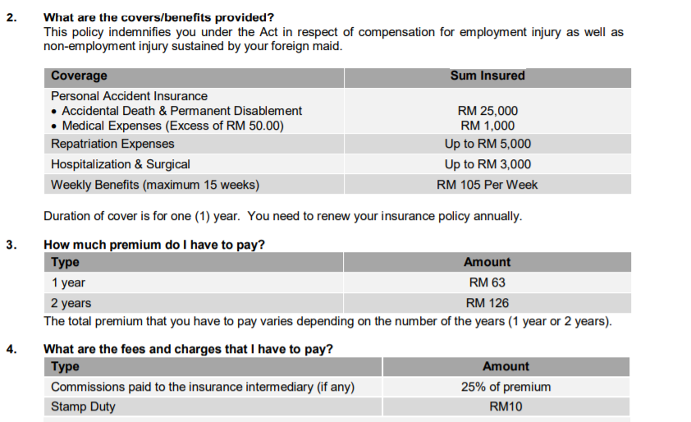
Coverage of insurance

Slide 5
Net income criteria for employers
No. | Country of Origin | Employer’s Net Income | Payment (Personal Bond)
1. | Indonesia | RM 3,000.00 | RM 250.00
2. | The Phillipines | RM 5,000.00 | RM750.00
3. | Sri Lanka | RM 5,000.00 | RM750.00
4. | Thailand | RM 3,000.00 | RM 250.00
5. | Cambodia | RM 3,000.00 | RM 250.00
6. | India | RM 5,000.00 | RM 750.00
7. | Laos | RM 3,000.00 | RM 1500.00
8. | Vietnam | RM 3,000.00 | RM 1500.00

Slide 6
Issues associated with Domestic Workers
Not covered by certain provisions in the Employment Act – absence of protection including healthcare
Not covered by minimum wage - wages determined by bilateral agreement and MOUs
Work in isolation, working long hours, abuse,
Lack of food and water
Lack of sanitary needs
Lack of sleep or proper place to sleep and lack of privacy

Slide 7
Physical Access and Affordability to Healthcare
While public healthcare is accessible to everyone including documented workers, domestic workers access to public healthcare in dependent on the employer
Undocumented domestic workers access private healthcare which is very expensive.
Insurance is not in tandem with the high cost of the healthcare

Slide 8
Not allowed to get married or pregnant – will face deportation or cancellation of work permits. Many resort to illegal and unsafe abortions, unwanted pregnancies, reproductive tract infections, sexually transmitted infections (including HIV)
Contraction of communicable diseases also results in deportation (HIV, STD, TB) – many don’t seek treatment

Slide 9
Recommendations
Recognise Domestic Workers as Worker and Domestic work as Work and accord them all the protection under the Employment Act
Lower health care charges for migrants and accord them the same charges given to nationals. Subsidise the healthcare cost with the levy (RM410-590)
Allow undocumented workers/migrants to access public healthcare without the fear of arrest and detention
Remove pregnancy and communicable diseases as a cause for deportation and allow migrants to seek treatment in the country
Treatment for communicable diseases and other epidemic diseases should be free for migrants

