Slide 1
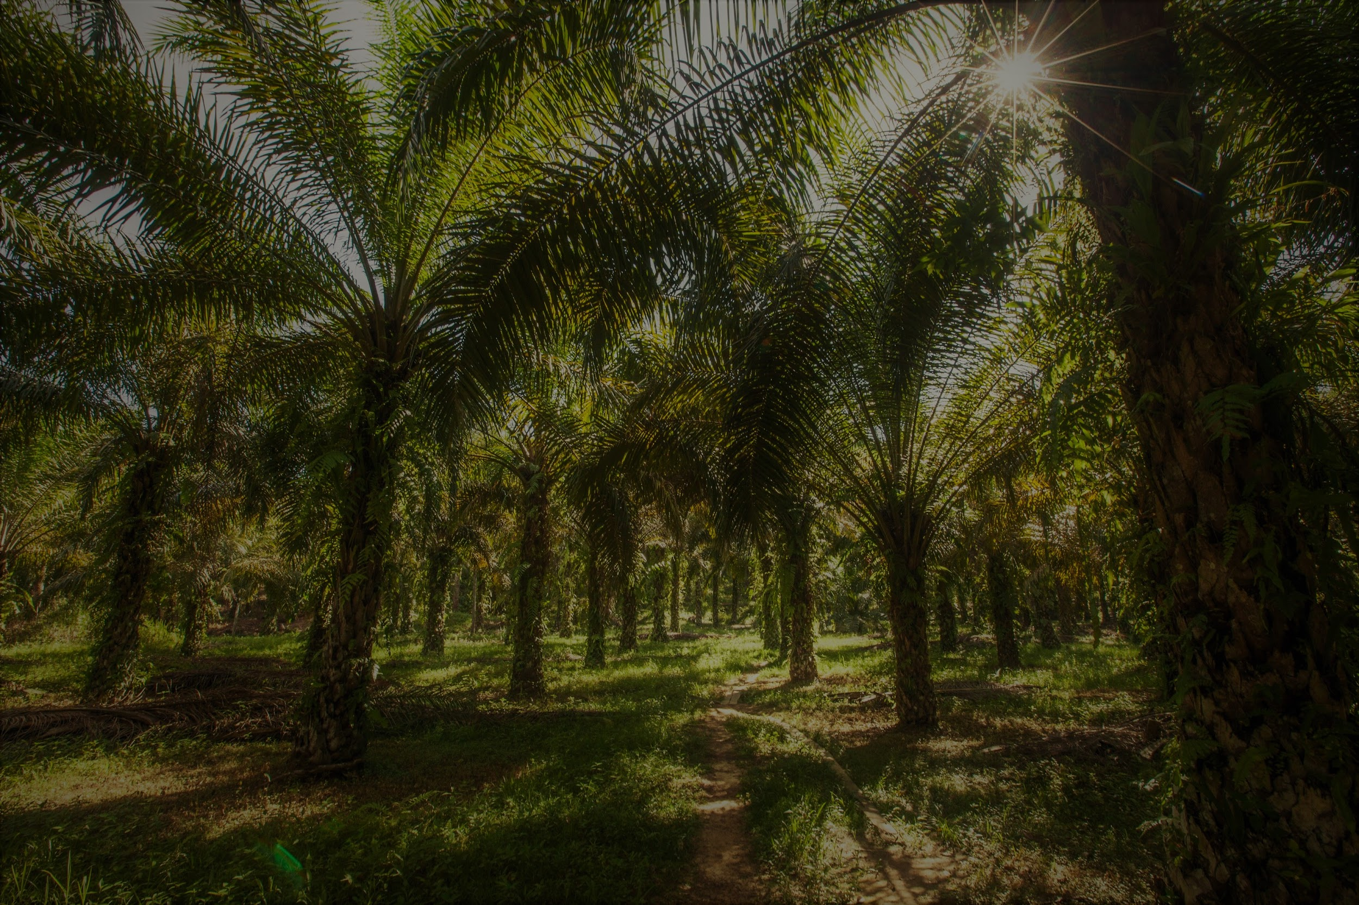

Occupational Health of Migrant Workers
Prema Arasan,
Programme Manager
TENAGANITA Women’s Work Force

Slide 2
Occupational Diseases And Poisoning Investigation Until September 2018
(source: dosh.gov.my)
Type of Disease | Number of Cases Reported
Occupational Lung Diseases (OLD) | 96
Occupational Skin Diseases (OSD) | 221
Occupational Noise Related Hearing Disorders (HD) | 4506
Occupational Muscular-Skeletal Disorders (OMSD) | 188
Occupational Poisoning | 77
Disease Caused by Physical Agent | 2
Disease Caused by Biological Agent | 28

Slide 3
Occupational Diseases And Poisoning Investigation Until September 2018
(source: dosh.gov.my)
Type of Disease | Number of Cases Reported
Occupational Cancer | 1
Psychosocial Problems | 0
Other Types of Occupational Diseases | 6
Non Occupational Diseases | 14
TOTAL | 5139

Slide 4
Occupational Health issues in plantation sector (palm oil)

Slide 5
1. Physical hazard (noise, vibration, heat and dust
2. Ergonomic Hazard (manual handling, repetitive movement)
3. Psychological (stress, sexual harassment, discrimination)
4. chemical ( pesticides)
5. Biological ( bacteria, insects, snakes, virsus dengue

Slide 6
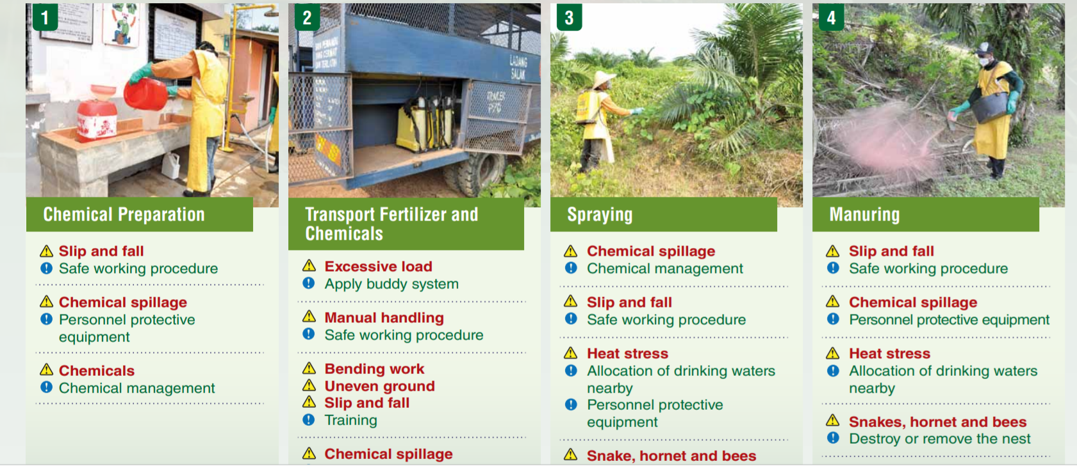

Slide 7
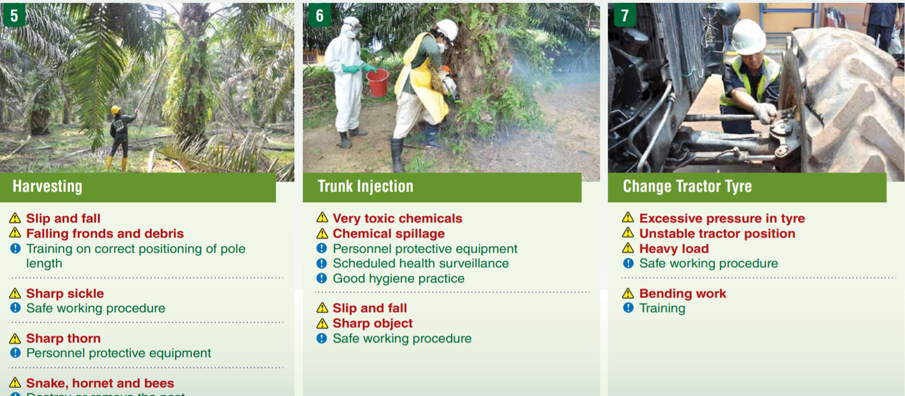

Slide 8

Common Health Hazards
Noise
Repetitive, excessive noise causes long term hearing problems and can be a dangerous distraction, the cause of accidents. There were 4506 reported cases of Occupational Noise Related Hearing Disorders (HD) in 2018
Psychosocial Risks and Work Related Stress - from work overload and lack of rest and off-days. Stress can cause acute and chronic changes which can provoke long-term damage to systems and organs, particularly if the body cannot rest and recover.
Ergonomic Injuries
Back injuries, sprains and strains, wrist, shoulder, and elbow problems affect many plantation workers
Respiratory Diseases
Invisible, fine, toxic mixture of hazardous materials and fibres that can damage the lungs, leading to diseases such as chronic obstructive pulmonary, asthma and silicosis

Slide 9
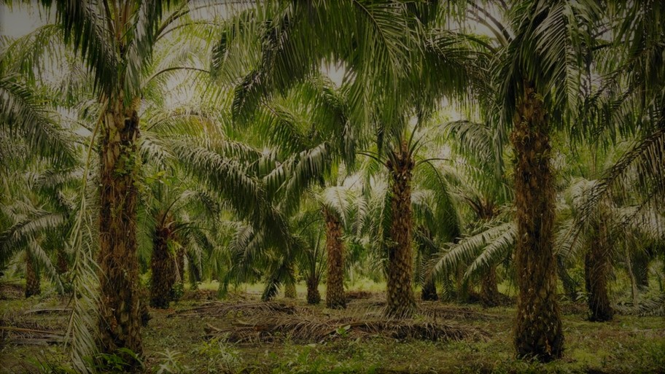
Plantation-palm oil
Agriculture is among the three most dangerous sectors to work in at any age in terms of work-related fatalities, non-fatal accidents and occupational diseases (ILO)
The majority of workers (about 85%), in oil palm plantations in Malaysia are migrant workers from neighbouring countries such as Indonesia, Bangladesh, Nepal, Cambodia and India. In some plantations, there are also workers from the Refugee Rohingya Communities. (Tenaganita Finding from few plantation, Selangor, JB, Perak, Sawarak and Sabah)

Slide 10
Last year alone, almost 400 cases handled by Tenaganita. Out of it, around 80 cases involved migrant workers from Penisular and Sabah& Sarawak. A lot of dead bodies are sent back to Indonesia.
The case documentation had revealed almost all of them have an occupational health problem, this includes psychosocial hazards such as sexual harassment and abuse)
(Tenaganita database)

Slide 11
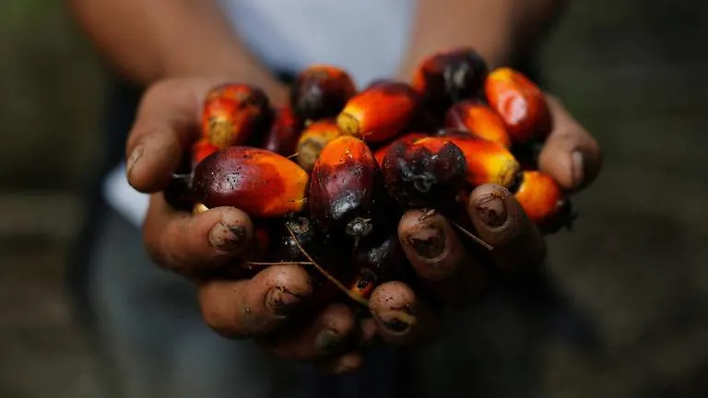
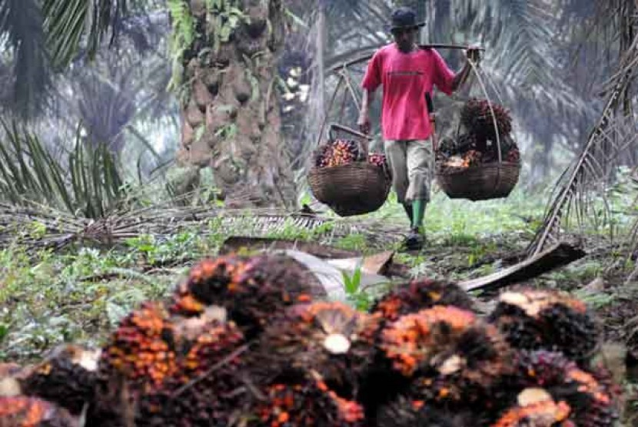
The Job scope
Migrant workers carry out typical plantation work such as harvesting of ripe fruits; pruning of oil palms, applying fertilizer to the palms, transporting the fruit bunches to the mills and spraying herbicide. Heavily dependent on migrant workers, without whom essential work such as harvesting, collection and evacuation of fresh fruits would quickly grind to a halt.

Slide 12
PPE
These workers are provided PPE such as apron, mask, gloves, and boots. The gloves and masks glove and mask need to be changed every day, but they are replaced usually every two days. This is very distressing as there are tremendous hazardous impacts to their health.
Workers’ understanding of the dangers of these chemicals seems to be limited, and hence the likelihood of chronic poisoning is high.

Slide 13
HEALTH CARE SUPPORT
There are clinics in the estates in most plantations but workers feel that it can only deal with a minor illness such as cough, flu or fever. There are no occupational health doctors at estates.
Those workers handling chemicals are not given access for annual health check up .
Our finding showed that the migrant workers are not brifed about the danger of the chemical as requested by section 21, OSHA 1994.

Slide 14
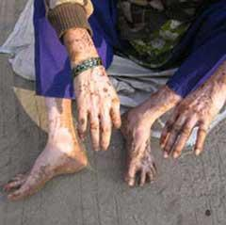
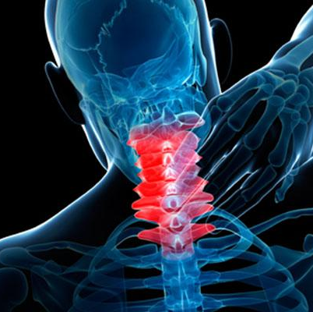
Pesticide exposure
Pesticides pose risks of short- and long- term illness to farmworkers and their families. Workers can be exposed to toxic pesticides due to spills and splashes, defective, missing or inadequate protective equipment, direct spray, or drift
Ergonomic Injuries
Workers in agricultural operations for both crop and animal production typically use repetitive motions in awkward positions and which can cause musculoskeletal injuries

Slide 15
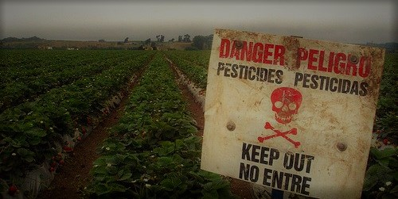
Long-Term Effects of Pesticide Exposure
Exposure to the herbicide atrazine has been linked to menstrual disorders, low-birth weight babies and birth defects.
A 2013 study linked legacy pesticides, including the organochlorine insecticide lindane, to increased risk of endometriosis in women.
Pesticides have been linked to lower sperm count and fewer normal sperm.

Slide 16
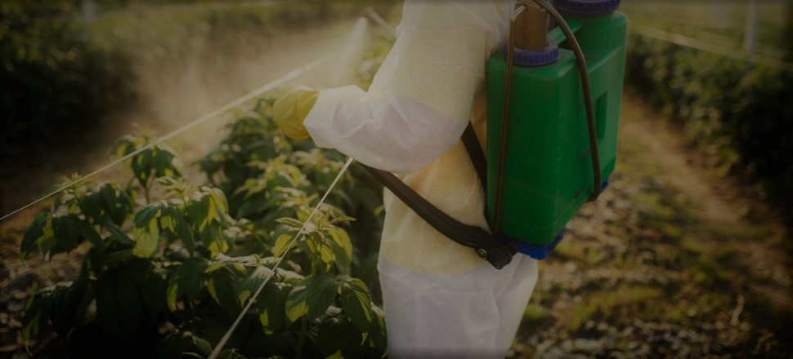
The Struggle of the Women Workers
Many migrant workers in the plantations are exposed to highly toxic chemicals when applying herbicides, pesticides and fertilisers.Personal personal protective equipment (PPE) provided is often unsuitable for the hot and humid Malaysian climate
Much of the women’s work involved lifting and carrying heavy loads such as chemicals and fertilisers, and repetitive bending and squatting which took a heavy toll on the body
Complaints of body aches and prolapsed wombs are frequent, but almost always dismissed as malingering, without giving due regard for their association with the workplace

Slide 17
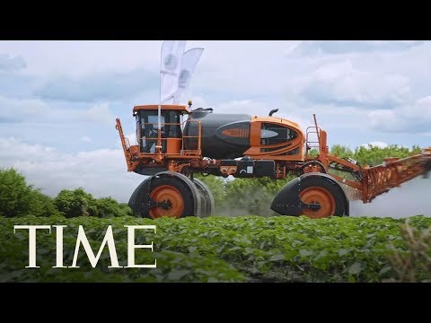
“A Mother's Exposure to Pesticides During Pregnancy May Raise Children's Autism Risk | TIME”

Slide 18

The Politics of Paraquat
Paraquat is a deadly poison that is widely used in agriculture to control weeds but it also poses serious hazards to humans which included lung damage, skin lesions, dermatitis and nose bleeds.
There have been cases of women handling paraquat who suffered from miscarriages. There has also been cases of severe injuries due to paraquat where one of them lost one eye and another suffered from internal complications.

Slide 19
“As the workers endured their daily dose of exposure to paraquat, they began to suffer symptoms like fatigue, blurred vision, frequent tearing of the eyes, giddiness, itch and rashes. Sores appeared on their backs where the skin was constantly wetted by leaking spray tanks. There was breathing problems aggravated by inhaling the paraquat mist that blew in their faces with the constant gusts of wind. Other problems include loss of appetite and discolouration and peeling of nails.”
“We had to spray around the trees and along pathways. After spraying, the weeds die very quickly. Every time I sprayed, the smell was unbearable. It even penetrated the mask. I felt suffocated… giddy… sometimes nauseated… my hands itched and I had sores on my back and thighs and around the genital area… I remember one bad accident in the fields. The nozzle of the spray tank had become clogged with grass, so I tried to open and clean it. But the spray mixture splashed into my eyes and they began smarting. The next morning, my eyes were swollen and I could not see.”
Quoated from “The Politics of Paraquat”

Slide 20
Acute Effects
Immediate effects occur frequently among paraquat users and include
Eye injury, nosebleed, irritation and burns of skin and nails;
Nausea, vomiting or pains, and difficulty in breathing may develop with a delay of two to three days; and
Death.
Chronic Effects
Over time, paraquat could affect the lungs, nerve system and brain, skin and reproduction. It could pose birth defects and impact children's brain growth. More recently, more studies have validated concerns over paraquat and an increased risk for developing Parkinson's Disease (PD)

Slide 21
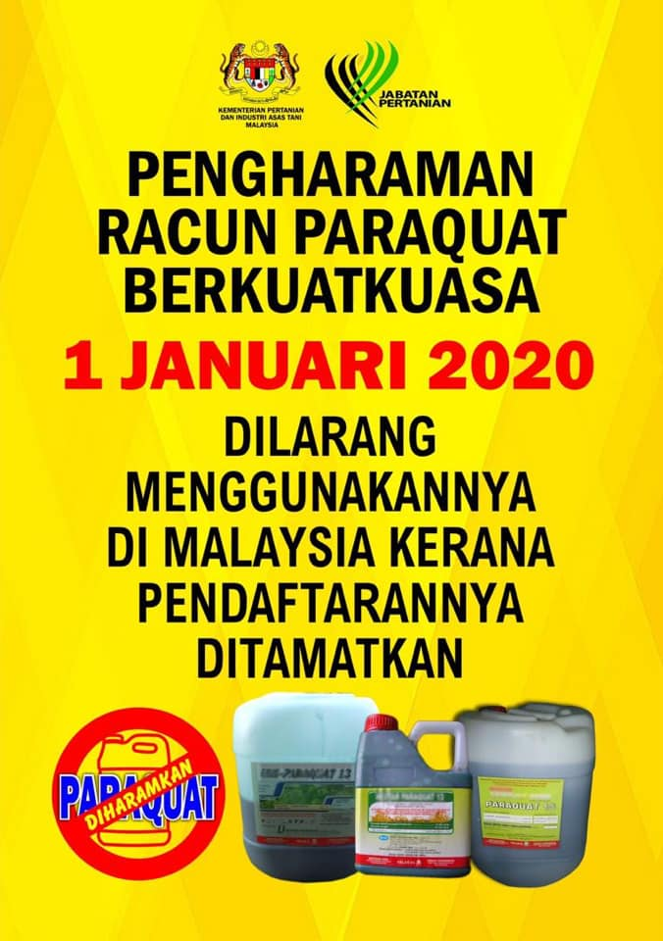
PaRAQUAT BAN!
Any use of paraquat beginning would be subject to the Poisons Act 1952 and users will be fined up to RM10,000 for a first offence and RM50,000 for a second offence.
source: Paraquat ban will not have major impact on agriculture costs https://www.nst.com.my/news/nation/2019/03/470501/paraquat-ban-will-not-have-major-impact-agriculture-costs

Slide 22
Occupational Poisoning and diseases
NADOPOD , Notification of Accident, Dangerous Occurence, Poisoning and Occupational Disease.
form JKKP 7 to report within 7 days.
Use and Standard of Exposure Chemical Hazardous to Health) Regulations 2000 (USECHH Regulations) was made to provide a legal framework to control exposure of chemical hazardous to health at workplace. To inform the workers of the chemical that they are handling.

Slide 23
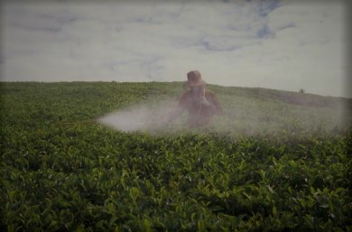
I’ve never been normal again’: Indonesian women risk health to supply palm oil to the West (https://www.statnews.com/2017/04/18/palm-oil-chemical-illness/)
“After several years of working as a pesticide sprayer, Sari said, her health began to deteriorate. Sari found it increasingly difficult to breathe during and after work. Headaches were accompanied by bouts of vomiting. Every two or three months, she would faint for no particular reason. Then one day in 2010, she woke up, disoriented on a hospital bed. The last thing she remembered was taking a brief break during work.
An X-ray revealed that she had a lung condition, likely caused by persistent exposure to the chemicals she sprayed on palm oil trees. “I never used to have respiratory problems until I started working with them,” Sari said.”

Slide 24
Tenaganita has worked with plantation workers who have suffered from health issues and skin color changes due to exposure to Paraquat, A-1 pesticides and other harmful chemicals while working in plantations.
Plantation workers complain of health problems like skin diseases and back pains due to long working hours and insufficient time to rest and clean the chemicals off of them, as well lack of proper Personal Protective Equipment (PPE) while handling dangerous chemicals.

Slide 25
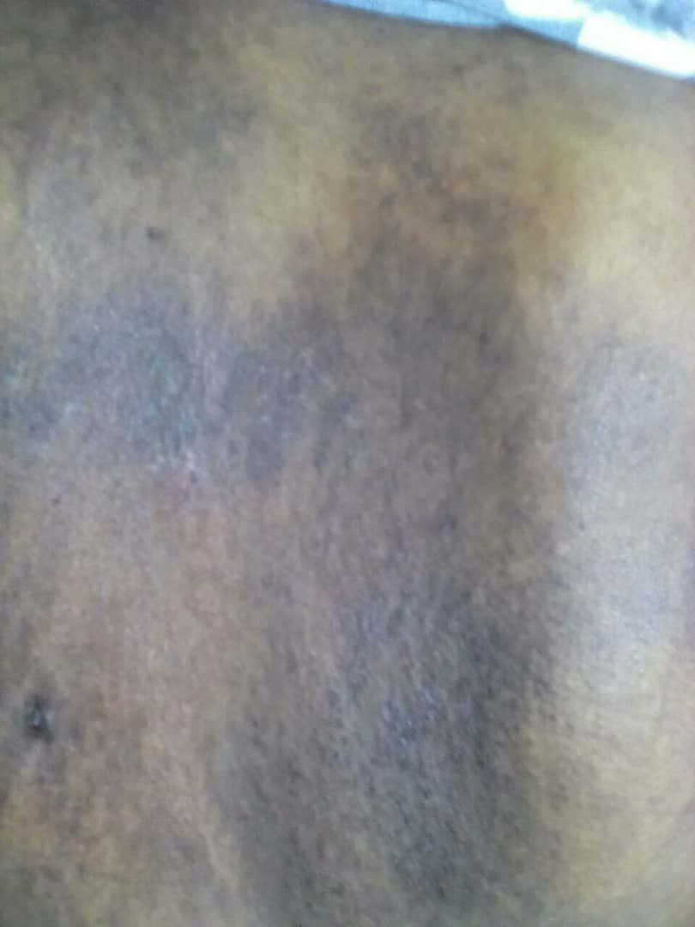
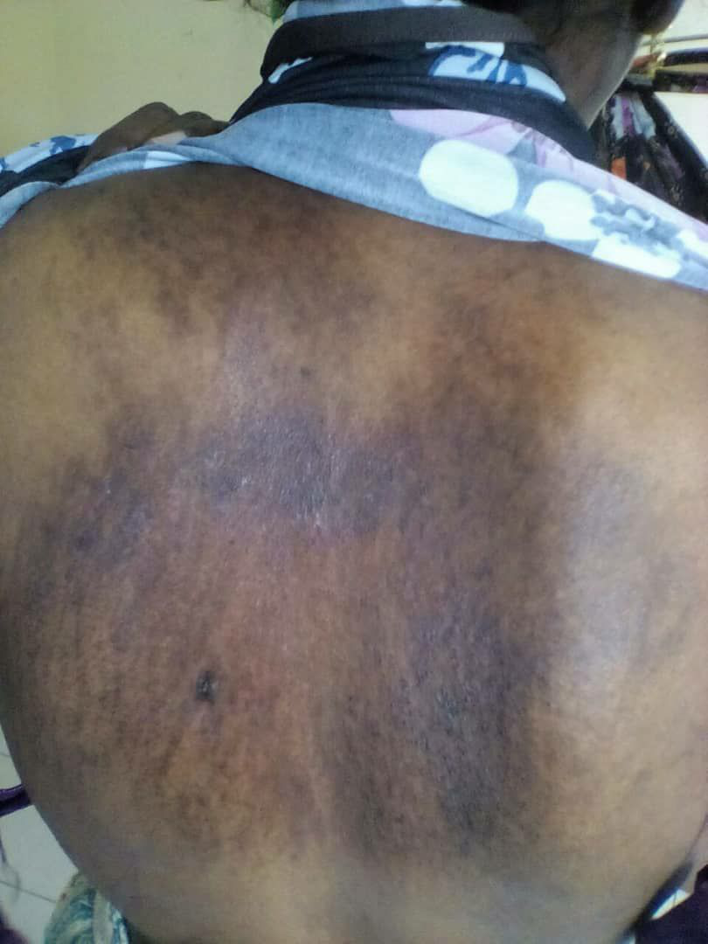
Skin irritation at the back of the body due to pesticie tank leakage

Slide 26
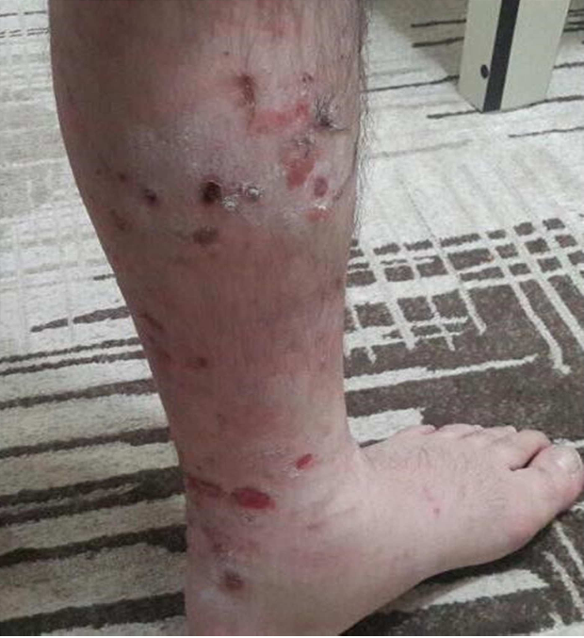
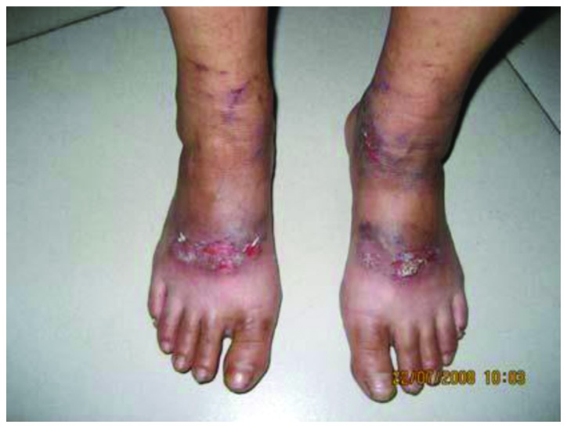
INFECTION CAUSED BY SAFETY BOOTS

Slide 27
Way Forward
The companies should also assimilate and internalise the frameworks enshrined in the various ILO core conventions and the UN Guiding Principles on Business and Human Rights, for it continues to build on the existing standard established by the Roundtable on Sustainable Palm Oil (RSPO).
Comprehensive policy

Slide 28
HEALTH SUPPORT IS FOR ALL,
THAT INCLUDES MIGRANTS AND REFUGEES
Q & A
Prema Arasan
Programme Manager
TENAGANITA Women’s Work Force
prema.a@tenaganita.net

