Slide 1
Occupational Health for Migrant Workers
Migrant Healthcare in Malaysia

Slide 2
Legislations and Standards Related to Migrant Workers

Slide 3
International
ILO (International Labor Organization)
Article 10 ILO Convention 143 (1975)
International Symposium on Safety & Health of Migrant Workers 1979
Sustainable Development Goal
Sustainable Development Goal 8 promotes decent work and economic growth, committing to “protect labor rights and promote safe and secure working environments for all workers, including migrant workers”

Slide 4
Local (Malaysia)
Department of Occupational Safety and Health (DOSH), Ministry of Human Resource
  enforces the Factory and Machinery Act (FMA) 1967 and the Occupational Safety and Health Act (OSHA) 1994.
Employers are responsible for ensuring the safety, health and welfare of all employees. (Section 15, OSHA 1994)
Employees are responsible for ensuring reasonable care for the safety and health of himself and others who may be affected by his actions in the workplace (Section 24, OSHA 1994).

Slide 5
Local (Malaysia)
Ministry of Health
  FOMEMA
  SPIKPA
SOCSO
  Employment Injury Scheme for Foreign Workers
NIOSH
  Consultation & Training for OSH

Slide 6
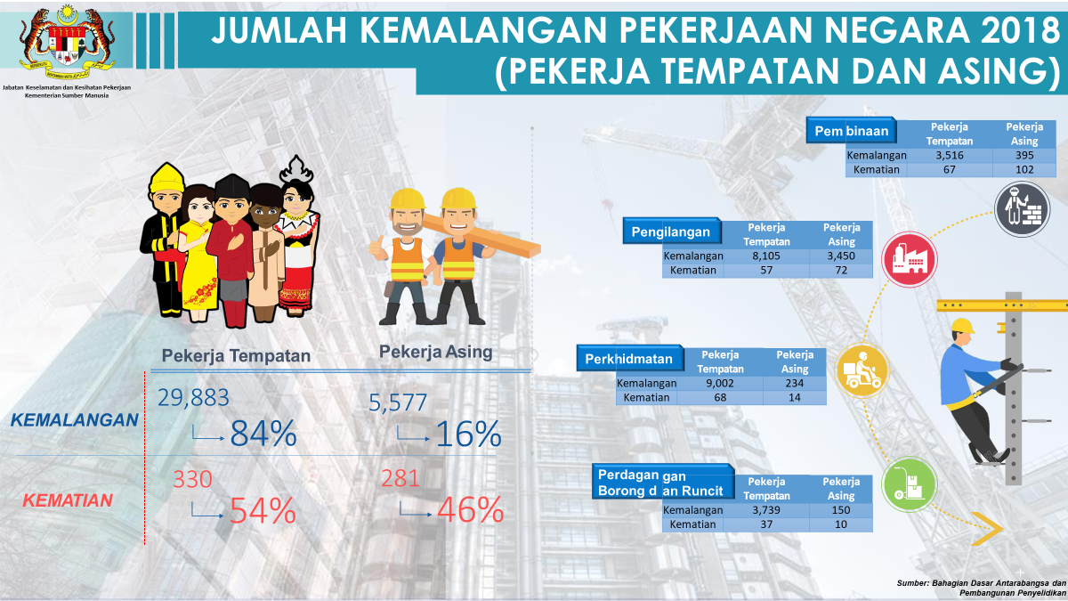

Slide 7
Organisations Related to Occupational Health
JKKP (DOSH) – legislation, standards, enforcement, promotion
NIOSH – training, consultation, research, information dissemination
PERKESO (SOCSO) – compensation, promotion, rehabilitation
Ministry of Health
Others:
  Universities: UKM,UPM, UM, USM
  Occupational Health Units in the industries,
e.g.: Exxon Mobil, Petronas
- NGOs : SOEM, MIHA, MSOSH

Slide 8
Organisations Related to Occupational Health
International
UK : Health Safety Executive (HSE)
US : NIOSH, ACGIH
International Labour Organisation (ILO)
International Agency For Research into Cancer (IARC)

Slide 9
Determinant Factors for Health
Biology and Genetics
Language and Cultural Barriers
Health Related Problems
Social Environment
Physical Environment
Access to Health Care

Slide 10
Biology and genetics
Genetic predispositions (e.g. Thalassemia, hemoglobinopathies)
Natural or acquired immunity (e.g., malaria, immunizations)
Migrant populations frequently have a different age/gender structure than the native population

Slide 11
Health Related Problems
Communicable diseases
  AIDS, tuberculosis, dengue, malaria, STDs
Tropical parasitic infections
Psychological disorders
  Social isolation, culture shock, goal– striving, cultural change
  Mental illness, behavior disorders, & psychosomatic complaints
Associated with drug addiction
  Suicide

Slide 12
Social environment
New social setting, language barrier
Legal migratory status
Marginalization
  Discrimination, stigmatization and xenophobia
Loss of familiar and social support
Socio-economic status
  Education level
  Occupation
  Income (Poverty)

Slide 13
Physical environment
Weather
Environment (eg., air quality)
Disease vectors distribution
Housing and workplace conditions

Slide 14
Physical environment…..cont
Housing conditions
Poor housing
  Overcrowding
  Noise disturbance
  Unsafe neighborhood
  Low indoor air quality
  Limited recreation and transportation opportunities
Concentrated in ethnic/minority enclaves

Slide 15
Access to health care
Vulnerabilities:
  Differences in health systems and practices between countries of origin and destination
  Legal limitations on access to care based on migration status
  Many barriers to access to care
    Culture, language, cost
    Limited awareness about available services
    Lack of health insurance
  Disparities in quality of care

Slide 16
Occupational Health Activities

Slide 17
Prevention Activities
Primary Prevention Health promotion Specific protection Regulations Control measures Immunisation Universal precautions | Secondary Prevention Early detection of hazards, disease and provision of early treatment Health Monitoring First Aid Emergency Response Plan | Tertiary Prevention Limited disability Rehabilitation Disability assessment Physiotherapy Compensation Return to Work programme

Slide 18
Competent Person Registered with DOSH
Authorised Gas Tester Entry Supervisor
Hygiene Technician 1 & 2
Indoor Air Quality Assessor
Lift Competent Person
Major Hazard Competent Person
Noise Competent person
Occupational Health Doctor
Safety and Health Officer
Site Safety Supervisor

Slide 19
Primary Prevention
Regulations
  OSHA 1994, FMA 1967, Regulations under OSHA and FMA, ICOP, Guidelines
Control measures
  Pre-employment – FOMEMA, Fitness For Work
  HIRARC – Chemical, Noise, Ergonomics etc
  Training & SOP
Immunisation
Universal precautions

Slide 20
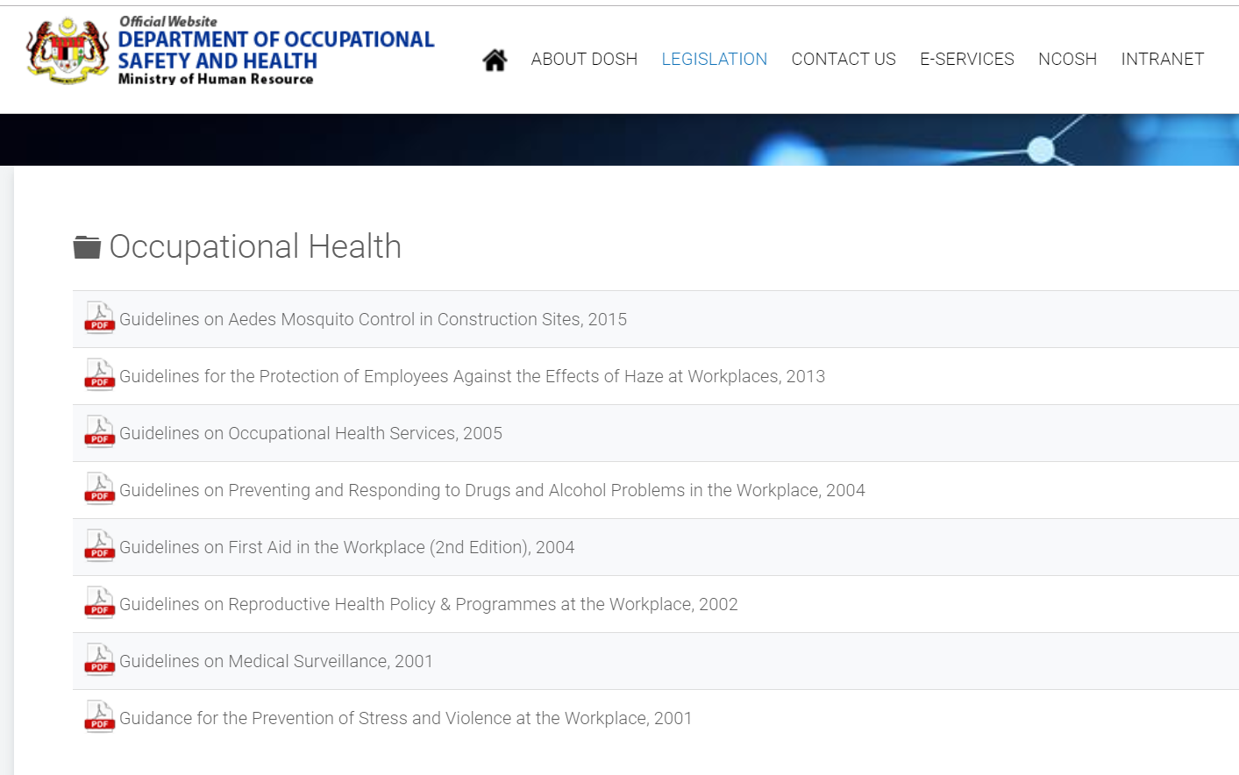

Slide 21
Secondary Prevention
Health Monitoring
  Regulatory Compliance – Medical Surveillance, Audiometry
  Health Surveillance Program
  Health and Wellness Program
First Aid
Emergency Response Plan

Slide 22
Tertiary Prevention
Disability assessment
Physiotherapy
Compensation
Rehabilitation
* Covered under SOCSO Employment Injury Scheme for Foreign Workers (starting 1st January 2019)

Slide 23
Training & Awareness
Conducted by DOSH, NIOSH, SOCSO (in collaboration with training centres), CIDB, external training centre etc.
Example:
Safety Passport Training
OSH Management Program
SOHELP
Health:
  Chemical handling and awareness
  Hearing Conservation Program
  Ergonomics and Fatigue Management
  Total Wellness and Health Promotion
*Future : Migrant Workers Safety Passport

Slide 24
Thank You
DR. MUHAMAD ARIFF BIN MUHAMAD NOORDIN
Occupational Health Doctor
Occupational Health Centre
NIOSH Malaysia
Email: drmuhamadariff@niosh.com.my

