Slide 1
Preliminary Findings on Nepali Migrant Worker Fatalities (2015)
(based on fatalities reported to the Embassy of Nepal, Malaysia)
Chan Chee Khoon
Bindiya Gurung
(for discussion only: please do not cite without permission)

Slide 2
Documented Migrant Workers (June 2015):
Nationality and Sector
 | Maids | Construction | Manufacturing | Services | Plantations | Agriculture | SUB-TOTAL
Bangladesh | 133 | 105,960 | 106,350 | 30,284 | 19,626 | 14,665 | 277,018
Cambodia | 4,045 | 268 | 3,539 | 1,048 | 274 | 350 | 9,524
China | 231 | 4,475 | 527 | 7,114 | 45 | 30 | 12,422
India | 949 | 9,893 | 4,007 | 61,196 | 24,333 | 39,246 | 139,624
Indonesia | 106,788 | 248,790 | 128,553 | 42,732 | 259,561 | 89,915 | 876,339
Laos | 36 | 3 | 22 | 7 | 2 | 4 | 74
Myanmar | 130 | 20,852 | 98,332 | 17,653 | 2,615 | 5,979 | 145,561
Nepal | 78 | 18,886 | 403,675 | 116,148 | 7,223 | 20,174 | 566,184
Pakistan | 53 | 29,849 | 3,828 | 6,245 | 8,846 | 24,393 | 73,214
Philippines | 42,186 | 4,122 | 4,663 | 5,839 | 4,876 | 4,835 | 66,521
Sri Lanka | 1,709 | 177 | 3,926 | 1,072 | 305 | 297 | 7,486
Thailand | 352 | 927 | 358 | 10,011 | 557 | 1,831 | 14,036
Vietnam | 895 | 5,533 | 47,626 | 1,830 | 114 | 593 | 56,591
Others | 76 | 346 | 142 | 309 | 34 | 12 | 919
SUB-TOTAL | 157,661 | 450,081 | 805,548 | 301,488 | 328,411 | 202,324 | 2,245,513
Source: Statistik Pas Lawatan Kerja Sementara (PLKS), June 2015
Jabatan Tenaga Kerja, Semenanjung Malaysia
Kementerian Sumber Manusia, Putrajaya

Slide 3
Estimates of (Un)documented migrant workers
MoHR (June 2015): 2,245,513 documented foreign workers
2011 amnesty exercise (6P): 1,303,126 undocumented migrants registered (Azizah Kassim, 2015, citing unpublished figures from Enforcement Division, Dept Immigration)
UNHCR roundtable (November 26, 2015): MTUC official, cited (unattributed) estimates of undocumented migrants ranging between 2 million (MoHR) and 4 million (MoHA)
Malaysia (2015): pop 31 million; labor force 14 million

Slide 4
Source: Azizah Kassim, 2015
(citing Enforcement Division, Dept Immigration)

Slide 5
Nepali Migrant Worker Fatalities in Malaysia*:
Causes of Death (2015)
N = 448
*reported to the Embassy of Nepal, KL

Slide 6
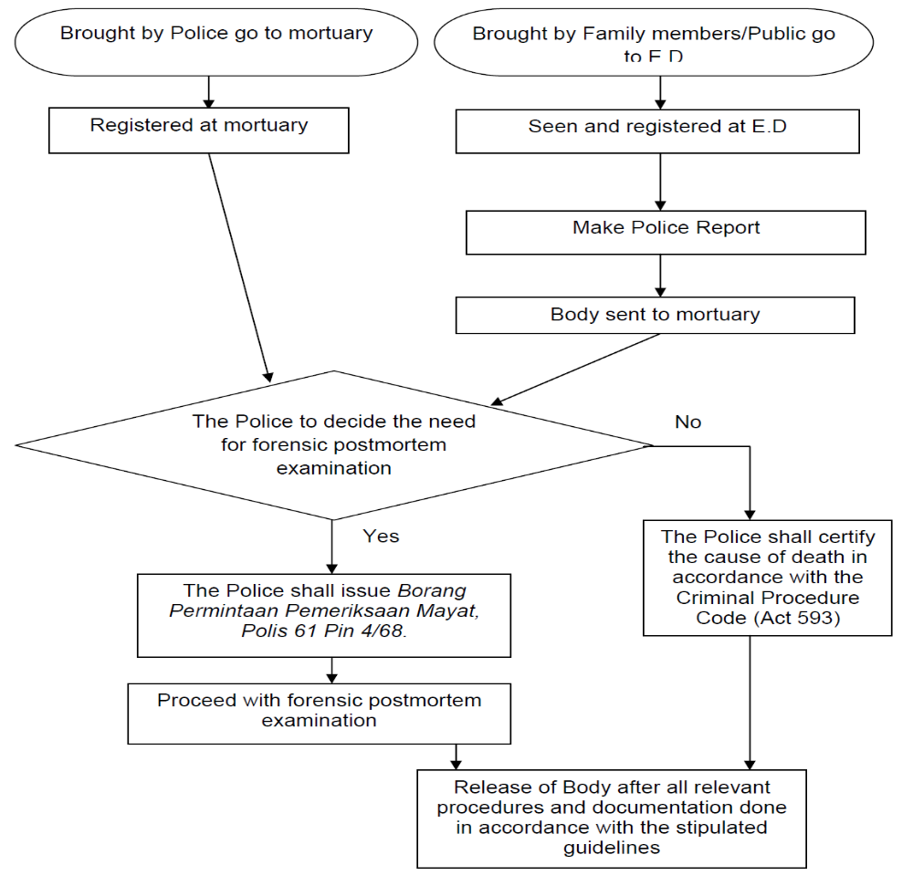
BID flowchart
S.O.P Forensic Medicine Services Health Ministry, 2012
S.O.P Forensic Medicine Ser
Health Ministry, 2012

Slide 7
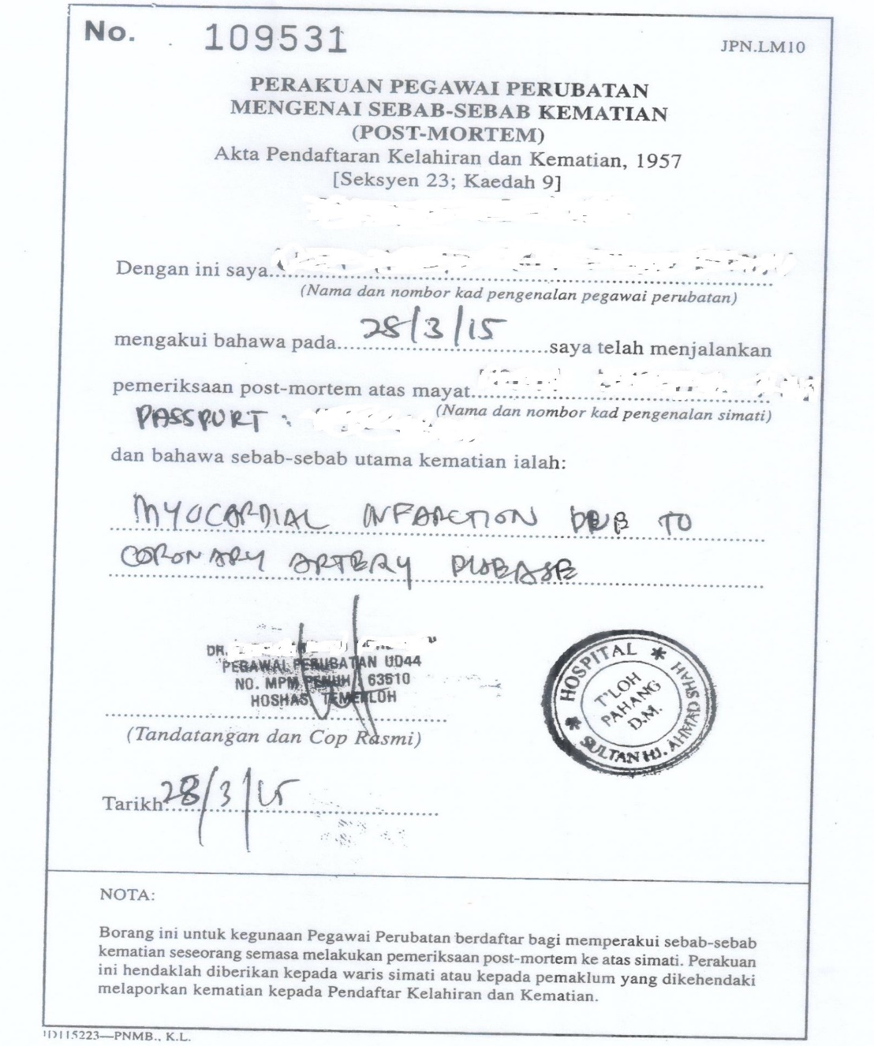
Post-Mortem Certificate (JPN.LM10)

Slide 8
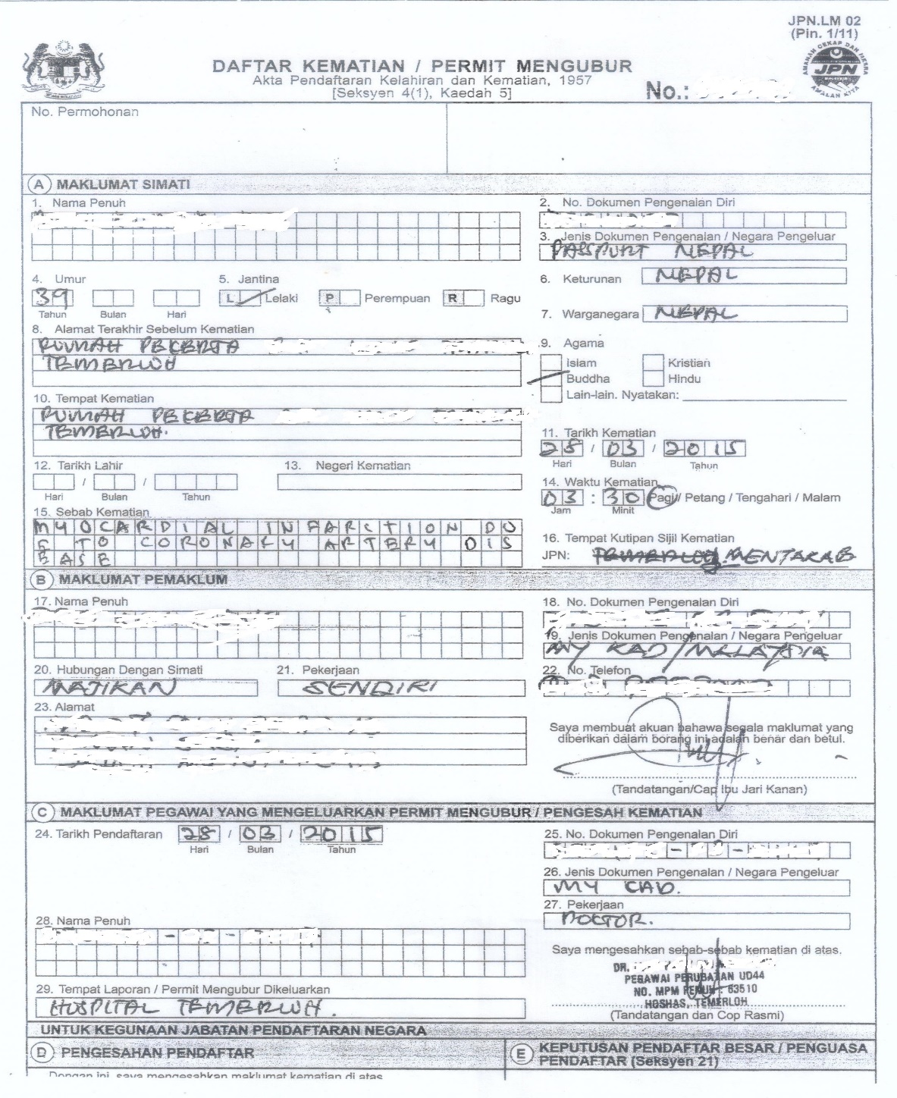
Death Registration/Burial Permit (JPN.LM02)

Slide 9
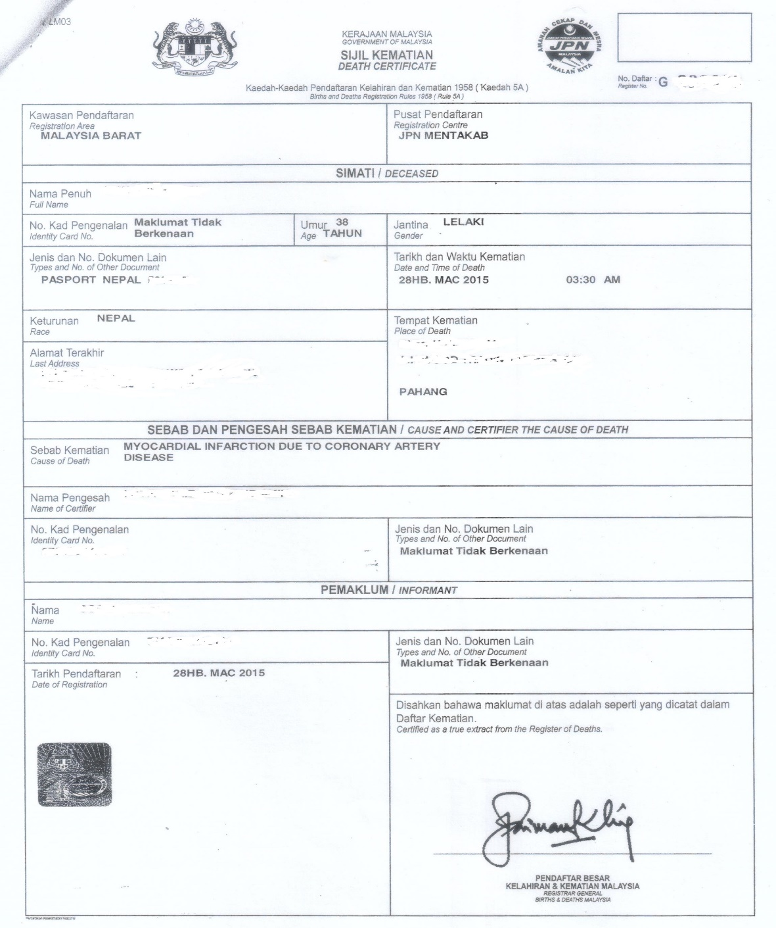
Death Certificate (JPN.LM03)

Slide 10
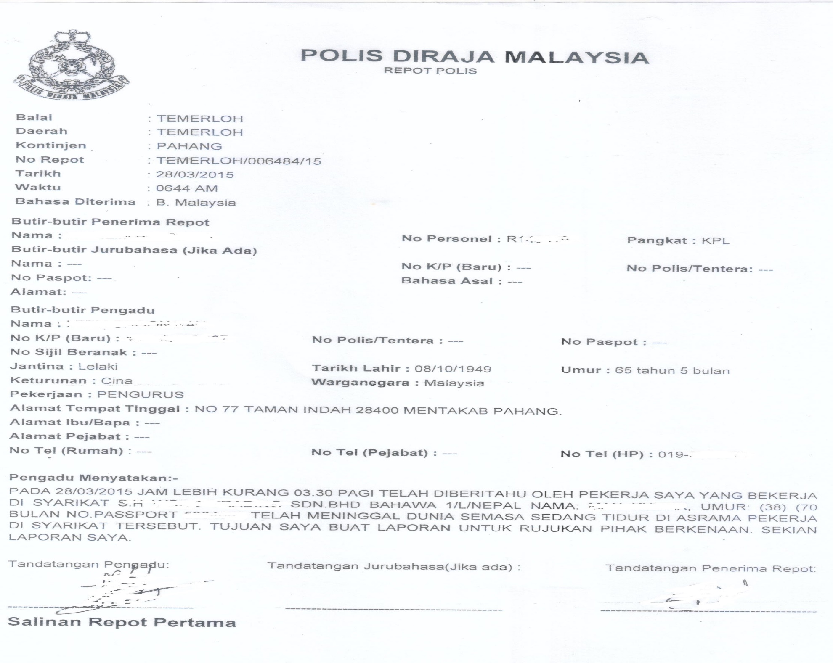

Slide 11
Nepali Migrant Workers (2015):
CV-related deaths* (N=100), by Job Category
*reported to the Embassy of Nepal, KL

Slide 12
Nepali Migrant Workers (2015):
CV-related deaths* (N=100), by Industry

Slide 13
Excess All-cause Mortality?
upper bound estimate in M’sia, 2015: 463/566,184 = 0.82
overall figure for Nepali workers employed abroad, FY2009-2015 (ILO): 1.59 per 1000 persons per year
Nepali general population, age-specific mortality rates 15–19 years, 20–24 years, 25–29 years, 30–34 years: 1.02, 1.46, 1.60 and 1.77 respectively (ILO)
before we conclude that there is no evidence of excess all-cause mortality among Nepali migrant workers in Malaysia, we should keep in mind the uncertain magnitude of healthy-worker/healthy-migrant effects which complicate meaningful comparisons against baseline mortality rates

Slide 14
Nepal & Malaysia: Age-standardized Suicide Rates
 | 2016 | 2015
Nepal¹
Both sexes | 9.6 | 10.1
Male | 11.4 | 11.9
Female | 8.0 | 8.5
Malaysia¹
Both sexes | 6.2 | 6.1
Male | 8.7 | 8.7
Female | 3.6 | 3.6
Nepali MWs in Malaysia (2015)² | mostly males aged 20-45 yrs
based on 566,184 documented MWs |  | 10.6
based on est. 700,000 MWs (incl. undoc) |  | 8.6
¹ WHO Global Health Observatory data repository (accessed May 12, 2019)
² Statistik Pas Lawatan Kerja Sementara (PLKS), Jabatan Tenaga Kerja, Semenanjung Malaysia,
Kementerian Sumber Manusia, Putrajaya (June 2015)

Slide 15
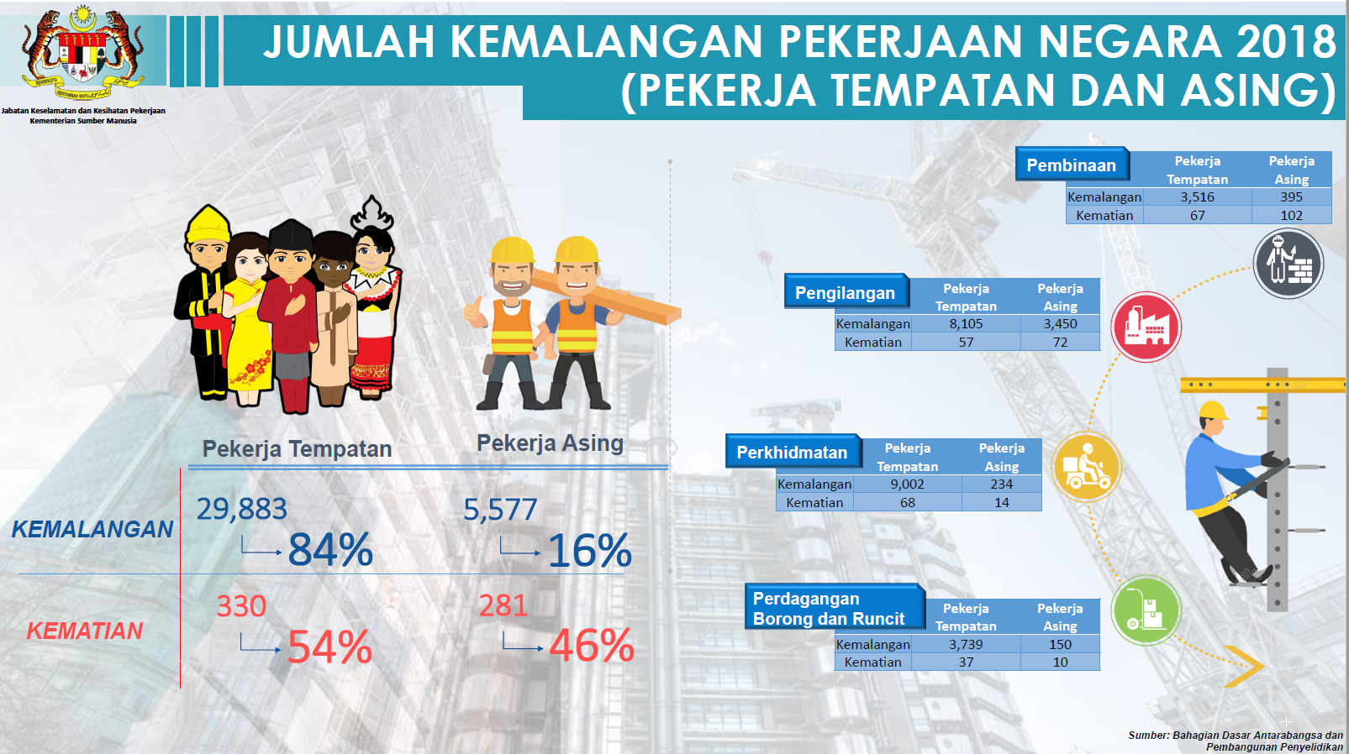

Slide 16
Follow-up Information Requirements
& Recommendations
updates to 2015 database (50/448 information pending cases, 17/448 no information cases)
review more detailed supportive documentation for all cases for causes of death
age & sex distribution of (documented) Nepali migrant workers in Malaysia
baseline mortality rates to estimate excess all-cause as well as disease-specific mortality
adjustments for healthy-worker/healthy-migrant effects ? comparison with similarly aged employed Nepalis in Nepal? with similarly aged employed Malaysians?
better estimates for numbers of undocumented Nepali migrant workers in Malaysia
case control study of risk factors for sudden death?

Slide 17
Thank You

